Slide 1


Unit Testing

Slide 2


What is Unit Test???
Hurry Slowly
(festina lente).
– Octavius, Caesar Augustus

Slide 3
Why Should We Use It???
Programming is like sex:
It may give some concrete results,
but that is not why we do it.
– apologies to Richard Feynman

Slide 4
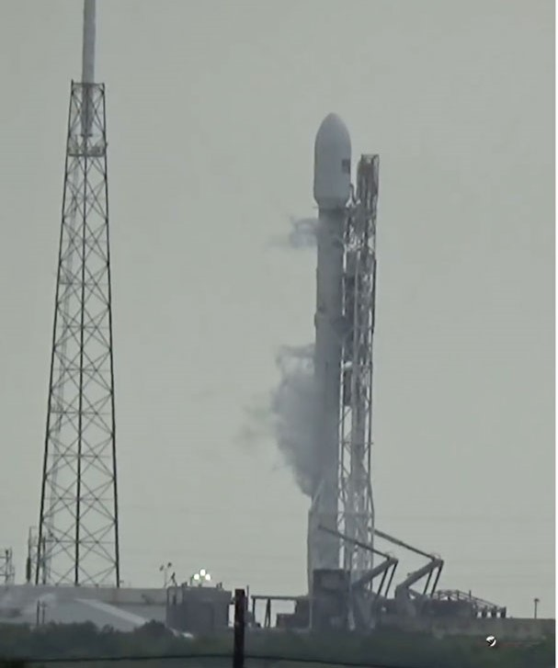
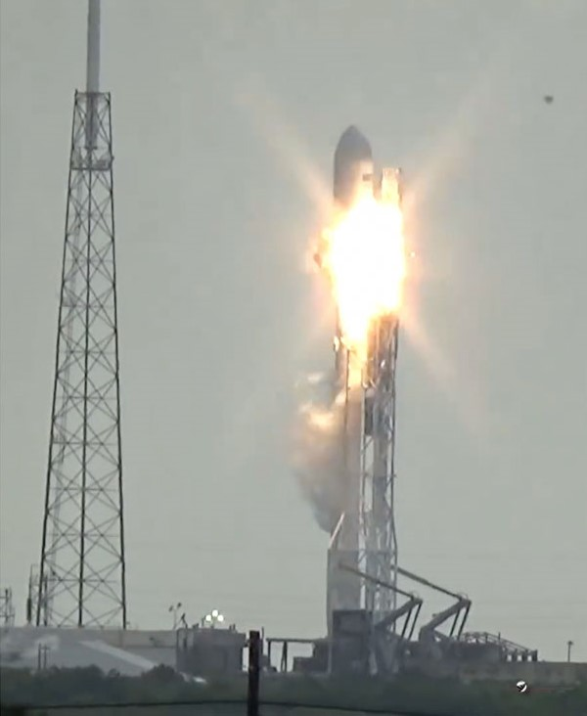
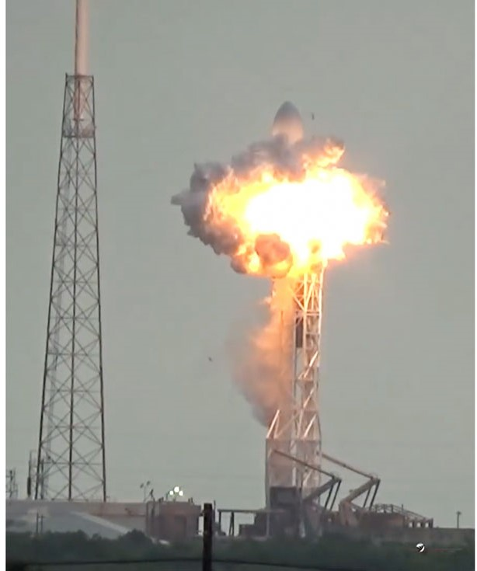
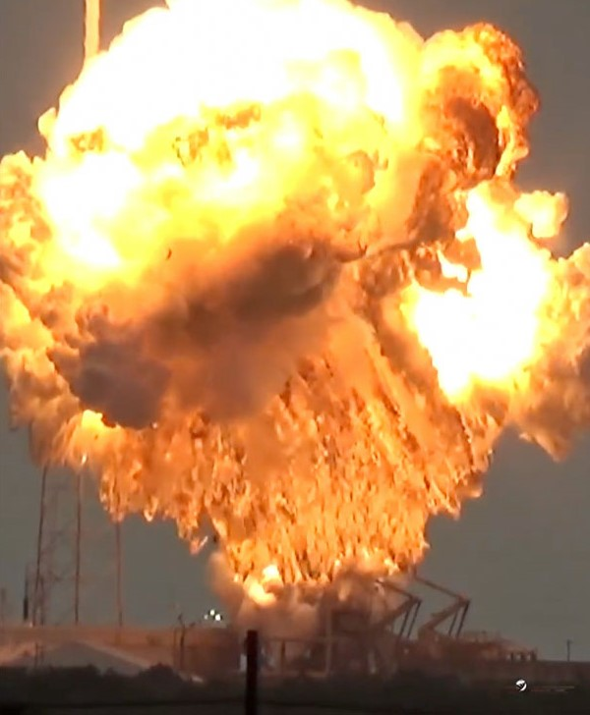
The harder you work, the luckier you get.– Gary Player

Slide 5
How to do that???
Don’t Panic!
– Douglas Adams

Slide 6
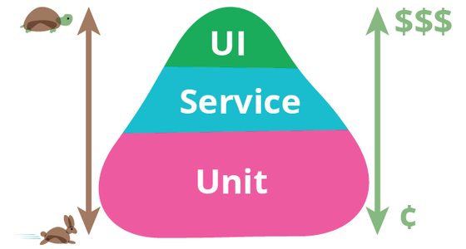
Testing Pyramid
Practice makes perfect – Anonymous

